Slide 1


Candidate pack for the post of
Head of People
July 2026
Closing date: 9am, Monday 3 August 2026

Slide 2

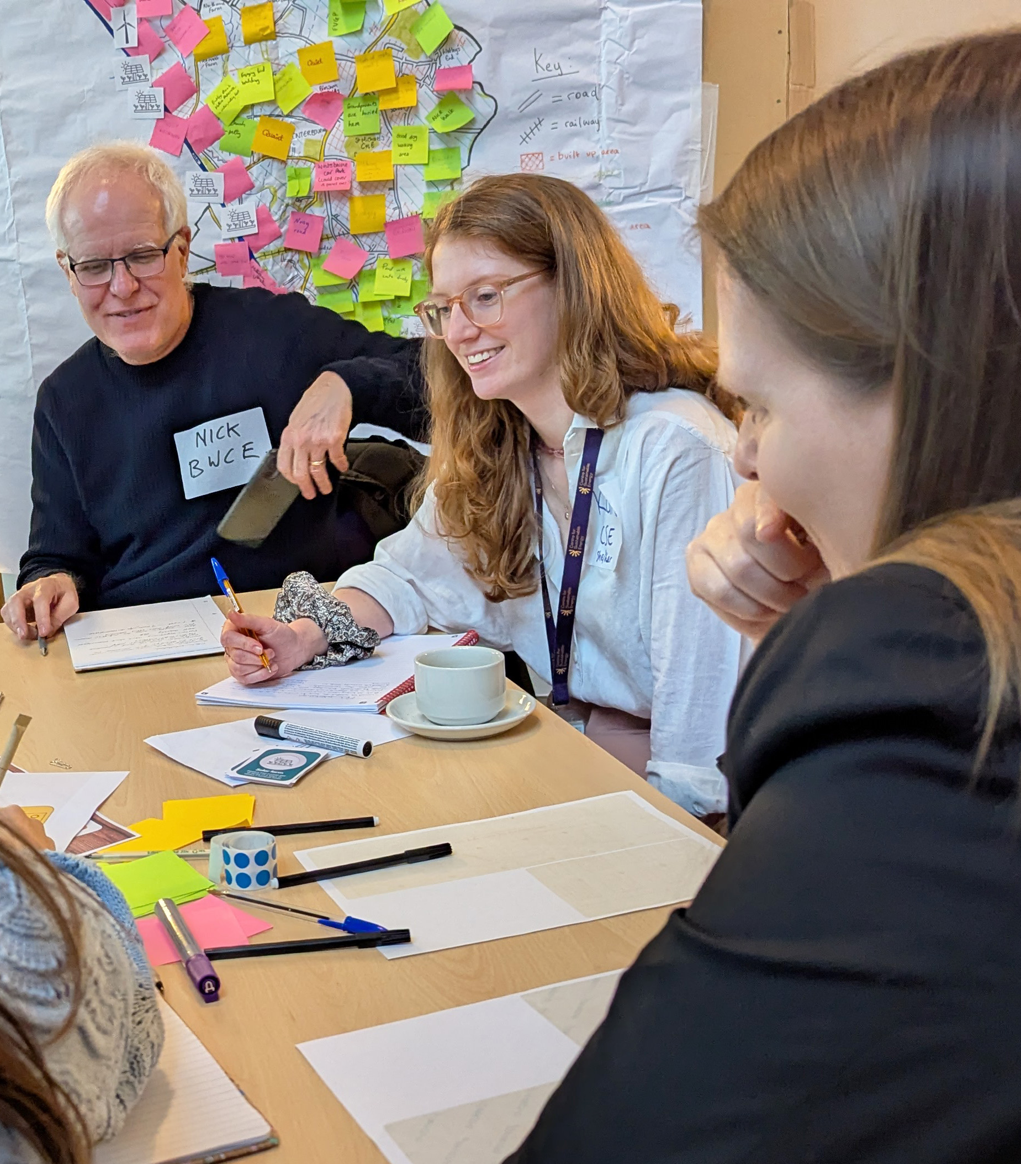
About the role
We're looking for someone to lead and continue to develop CSE's People function, helping ensure we have the people, capability and culture needed to deliver our mission.
You'll shape and deliver our draft People Strategy, working across the full breadth of the People function, from strategic business partnering and organisational development through to ER, recruitment, L&D, wellbeing, EDI, people operations and HR digital transformation.
You'll have the opportunity to advise and work closely with our Senior Leadership Team, be a member of the Senior Management Team and will work with staff across the organisation, bringing workforce insight and a people perspective to organisational decision-making.
This is a role with one foot in strategic leadership and one foot in delivery and will suit someone who is curious, pragmatic and collaborative, and who enjoys getting to the root causes of organisational challenges, developing strong relationships and delivering practical, lasting improvements.
You'll play a key role in continuing to strengthen our people systems, frameworks, line management capability and employee experience.

Slide 3
We're looking for a strategic and collaborative People leader who enjoys building, improving and embedding great people practice. You'll be naturally curious, analytical and pragmatic, with a genuine interest in understanding the root causes of organisational challenges, developing strong relationships and working with others to deliver meaningful, lasting change.
About you
Our ideal candidate will:
Be equally comfortable shaping strategy and delivering operational outcomes, moving confidently between big-picture thinking and hands-on delivery.
Be curious and analytical, enjoying the challenge of understanding organisational issues and finding practical, sustainable solutions.
Enjoy building organisational capability through effective systems, frameworks and continuous improvement.
Develop trusted relationships, adapting their approach to different stakeholders while coaching, influencing and bringing people with them through change.
Take a pragmatic and flexible approach, balancing best practice with organisational priorities while managing a broad and varied remit.
Be motivated by organisational impact and creating a high-performing, inclusive and values-led organisation that helps people do their best work.

Slide 4

You’ll be part of the Finance & Operations Team.
The Finance and Ops team provides the expertise, systems and support that enable CSE to deliver its mission. We support around 150 staff across the charity, plus a further 12 staff employed in our subsidiary Retrofit West, through our work in finance, people, IT, workplace management, and office support.
We provide the infrastructure, processes and practical support that help CSE operate effectively day to day, from managing finances and developing people capability to maintaining digital systems, supporting governance, managing our office environment and ensuring colleagues have the tools and support they need to do their jobs well.
We're committed to continuously improving our systems, services and ways of working, helping to create an effective, inclusive and values-led organisation where staff can do their best work.
About the team

Slide 5
Other teams in CSE
Household Energy Services
The Household Energy Services team gives advice and support on home energy and retrofit to householders, runs a freephone advice line and manages schemes for funding and installing home energy improvements.
Research & Analysis
The Research & Analysis team conduct research and build analytical tools and models that support better energy policies and more effective action to cut carbon emissions and reduce fuel poverty.
Development and External Affairs
The Development and External Affairs team leads fundraising, communications and policy work across the organisation, helping to secure funding, raise awareness of our work and drive national policy change.
Local and Community Empowerment
The LACE team supports communities, local authorities and young people to take positive action on sustainability, energy and the climate emergency.
Notes:
Local Authorities and Community Empowerment
The Local Authorities and Community Empowerment team supports communities, local authorities and young people to take positive action on sustainability, energy and the climate emergency.

Slide 6
Key responsibilities
This role combines strategic leadership with hands-on operational delivery across the full breadth of the People function.
Develop and deliver the People Strategy
Lead the development, delivery and ongoing evolution of CSE's People Strategy, ensuring it supports organisational priorities and helps CSE attract, retain and develop the people and capability needed to deliver its mission.
Partner with senior leaders
Act as a trusted advisor to the Senior Leadership Team and Senior Management Team, partnering with leaders to deliver organisational priorities, strengthen team effectiveness and address people-related challenges and opportunities.
Lead the employee experience and continuous improvement
Lead and continuously improve the employee experience across the full employee lifecycle, strengthening people frameworks, policies, processes, management capability, systems and ways of working to support organisational priorities.
Lead and develop the People function
Lead, develop and empower the People team, building capability, confidence and ownership while ensuring the delivery of a high-quality, proactive and people-centred service and continuing to strengthen people systems, services and ways of working across the organisation.

Slide 7
Key responsibilities (cont.)
Develop line managers and organisational capability
Partner with line managers across CSE to build confidence, capability and consistency in people management practice.
Lead people operations, risk and compliance
Lead on complex ER matters, employment law, people policy, safeguarding and people-related risk, ensuring a fair, compliant and values-led approach while maintaining effective people operations and governance.
Lead digital transformation and workforce insight
Develop people systems, data, reporting and insight to improve employee experience, support decision-making and strengthen organisational effectiveness.
Champion an inclusive and values-led culture
Help create and sustain an inclusive, equitable and values-led organisation where people can thrive and contribute to CSE's mission.
Safeguarding
Act as the safeguarding rep for staff, working closely with CSE's Designated Safeguarding Lead to ensure safeguarding concerns relating to staff are managed appropriately and in accordance with CSE's Safeguarding Policy.

Slide 8
Person specification
Area | Essential | Desirable
Strategic leadership and business partnering | Experience operating as a strategic People partner to senior leaders, helping leaders deliver organisational priorities, strengthen team effectiveness and navigate people-related challenges and opportunities. Comfortable operating across the full breadth of the People function, balancing strategic leadership with hands-on delivery across a broad and varied remit, while building trusted relationships across an organisation. | Experience working as part of a senior management team in a charitable, purpose-driven or values-led organisation.
People leadership and team development | Experience leading, developing and empowering People teams, building capability, confidence and ownership while fostering a collaborative and supportive team culture. Strong coaching skills and a commitment to helping others grow and succeed. | Experience overseeing learning and development strategy, programmes or functions.
People operations, employee experience and risk | Experience leading and improving people operations and the employee life cycle, from attraction and recruitment through to development, wellbeing, employee relations and offboarding. Strong knowledge of UK employment law, people policy and best practice, with experience balancing risk, fairness and organisational priorities while exercising sound professional judgement. | Experience of safeguarding responsibilities and/or working within a regulated, charitable or mission-driven environment.
Organisational development and continuous improvement | Experience building, improving and embedding people systems, frameworks, management capability and employee experience. Naturally curious and analytical, with the ability to identify root causes, solve problems and deliver practical, sustainable improvements. | Experience leading organisational development, change or transformation initiatives.

Slide 9
Person specification (cont.)
Area | Essential | Desirable
Digital capability and insight | Experience leading or embedding HR/People systems and using data, reporting and insight to improve employee experience, support decision-making and strengthen organisational effectiveness. Comfortable learning, implementing and improving digital systems and processes. | Experience implementing or optimising HR/People systems, digital services or self-service platforms.
Relationship building, influencing and adaptability | Exceptional relationship-building and influencing skills, with the ability to build trust quickly, adapt approach to different stakeholders and bring people with them through change. Collaborative, pragmatic and comfortable working across competing priorities and organisational needs. | Experience working across diverse functions, disciplines and stakeholder groups.
Professional approach and values | A collaborative, curious and pragmatic approach, with a genuine interest in understanding organisational challenges and delivering practical, lasting improvements. Committed to creating an inclusive, values-led organisation where people can thrive. Level 7 CIPD qualification and/or equivalent senior-level People experience.
Safeguarding and professional judgement | Strong judgement, discretion and experience supporting colleagues through sensitive and complex situations. Able to assess risk, provide appropriate support and escalate concerns where necessary. Willing and able to undertake safeguarding training and develop the knowledge and confidence required to act as CSE's staff safeguarding rep under the guidance of CSE ‘s safeguarding lead. | Previous experience of safeguarding responsibilities, safeguarding training or acting as a safeguarding lead.

Slide 10
Person specification (cont.)
Area | Essential | Desirable
Safeguarding and professional judgement | Strong judgement, discretion and experience supporting colleagues through sensitive and complex situations. Able to assess risk, provide appropriate support and escalate concerns where necessary. Willing and able to undertake safeguarding training and develop the knowledge and confidence required to act as CSE's staff safeguarding lead. | Understanding of safeguarding legislation, policies, and best practices.

Slide 11
Contract
This is a permanent role.
Role
Full-time (37.5 hours per week), with minimum three days a week at our Bristol office. We work flexibly where roles allow, with core working hours typically between 10am and 4pm.
Salary
The salary grade for this role is J (£50,285–£60,233). Appointments are normally made at the starting salary for the relevant grade.
Following successful completion of the probationary period, salaries are reviewed in line with CSE's pay progression arrangements. Thereafter, salaries are reviewed annually through CSE’s annual pay review process.
Key details
Closing date for applications
9am on Monday 3 August 2026.
Earliest possible start date
As soon as the successful candidate is available.
Safeguarding
CSE is committed to safer recruitment practices. Please note this role requires a basic DBS check.
Pre-employment checks
Any offer of employment will be subject to satisfactory pre-employment checks relevant to the role.
Reporting to
Director of Finance & Operations.

Slide 12

About us
The Centre for Sustainable Energy (CSE) supports people and organisations across the UK to tackle the climate emergency and end the suffering caused by cold homes.
We undertake practical work to support households and communities to act on energy, alongside original research and analysis to inform local and national policy.
Our vision is a world where sustainability is second nature, carbon emissions have been reduced to safe levels, and fuel poverty has been replaced by energy justice.
We are one of the UK’s leading sustainable energy charities, with a 45-year track record of award-winning impact, innovation and influence (as most recently detailed in our CSE Impact Report 2025-26). You can read more about our priorities, methods and approach in our organisational strategy for 2024–2028.
Charity number 298740

Slide 13
Our six Work Programmes
Our work falls into six broad areas we call our Work Programmes. They are where we are best placed to drive change and maximise our impact.
Fuel poverty
Our practical energy advice improves the wellbeing, energy literacy, and affordable warmth of those experiencing cold homes.
Housing energy retrofit
We support the delivery of high-quality and people-centred retrofit services to address British homes that aren’t fit for the future.
Local authority support and action for net zero
We help local authorities of all scales to plan and deliver their energy-related net zero goals.
Community action on energy
We design and manage community energy funds, support local groups to develop projects, and provide training, support and community engagement.
Future generations
Our youth-specific work inspires young people from all backgrounds to play a meaningful role in a more sustainable and fairer energy system.
Fairness in the energy system
We’re working to bring about a future energy system that is both low carbon and demonstrably fair.

Slide 14


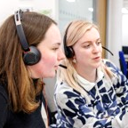
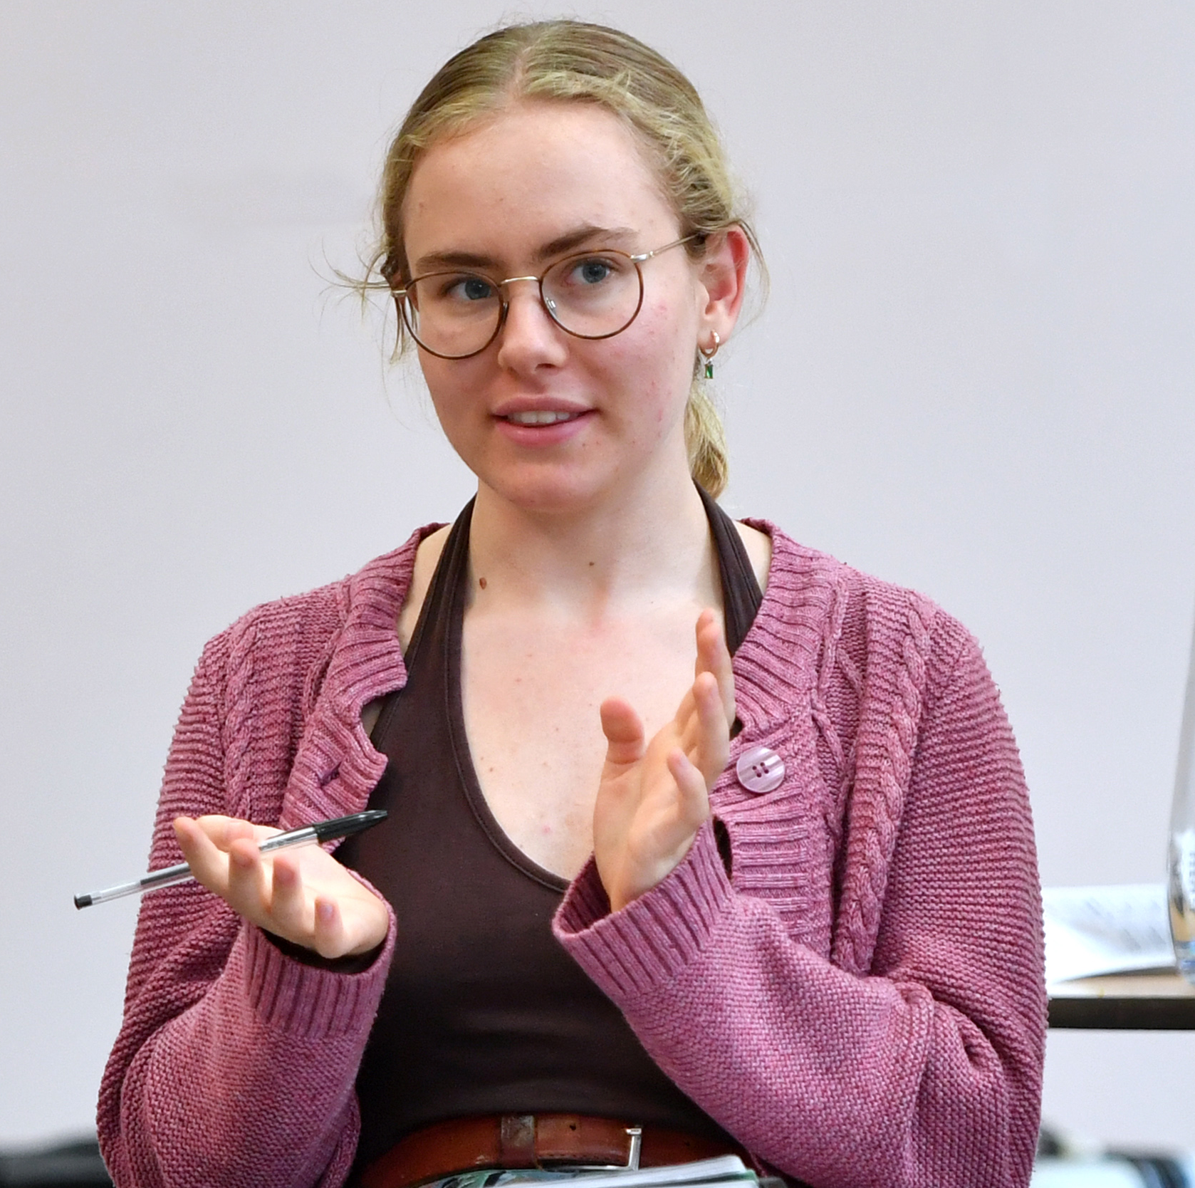

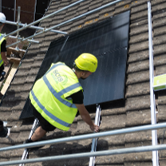


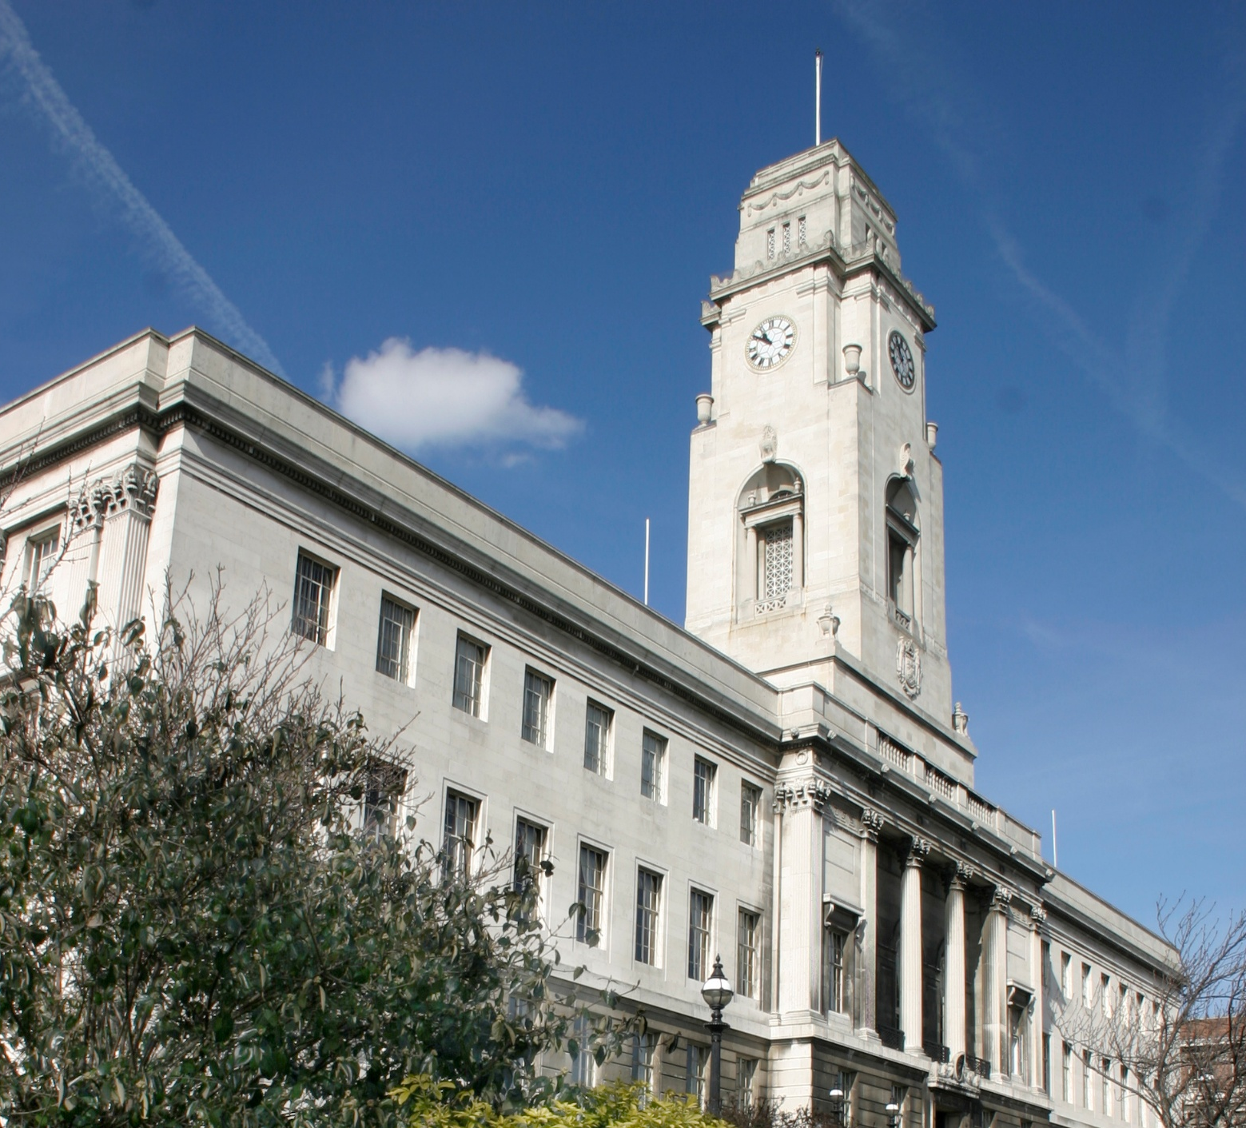
Our impact 2025-26
871
Community organisations supported to take action on climate change or tackling fuel poverty.
£2.3 million
Value of grants distributed to community organisations to run community-focused energy projects.
20,143
Households supported through our energy advice service.
1,850
Young people reached through our high-quality education and youth leadership programmes.
£33.9 million
Saved by people following our energy advice (through benefits claimed, energy efficiency measures installed, fuel vouchers and much more).
£1,685
Average saving per household who called our advice line.
6,969
Energy efficiency measures installed as a result of our projects.
31
Local authorities who used our services.

Slide 15

Our values
Commitment to our mission
We reflect our charitable purpose, vision and strategic objectives in our work, and we contribute to a culture where everyone feels welcomed, valued and able to belong.
Conscientiousness
We take responsibility for our work, deliver to the best of our ability, and work to improve while caring for CSE’s resources and reputation.
Collaboration
We share knowledge and experience generously, value others’ contributions, and communicate with openness and respect.
Initiative
We look for ways to improve outcomes, solve problems and try new approaches, while responding flexibly to change and supporting others to do the same.

Slide 16
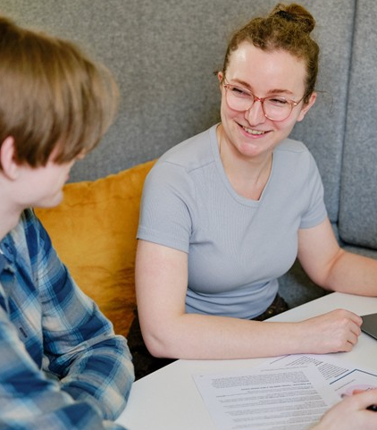
Our culture
We're a team of around 150 people who care about what they do and who they do it with. People join CSE because they want their work to matter and at CSE, it does.
You'll see the difference your work makes, whether that's an advice call that helps someone stay warm, a research report that changes how policymakers think, or a project that supports a community to take climate action.
Our work is mostly project-driven and genuinely collaborative. You'll work across teams, connect with colleagues with different expertise, and bring your own expertise to problems that sometimes don't have easy answers. It's varied and often fast-moving. Some roles involve supporting people in difficult situations, so it can be demanding but teams work closely together and it's easy to ask for help.

Slide 17
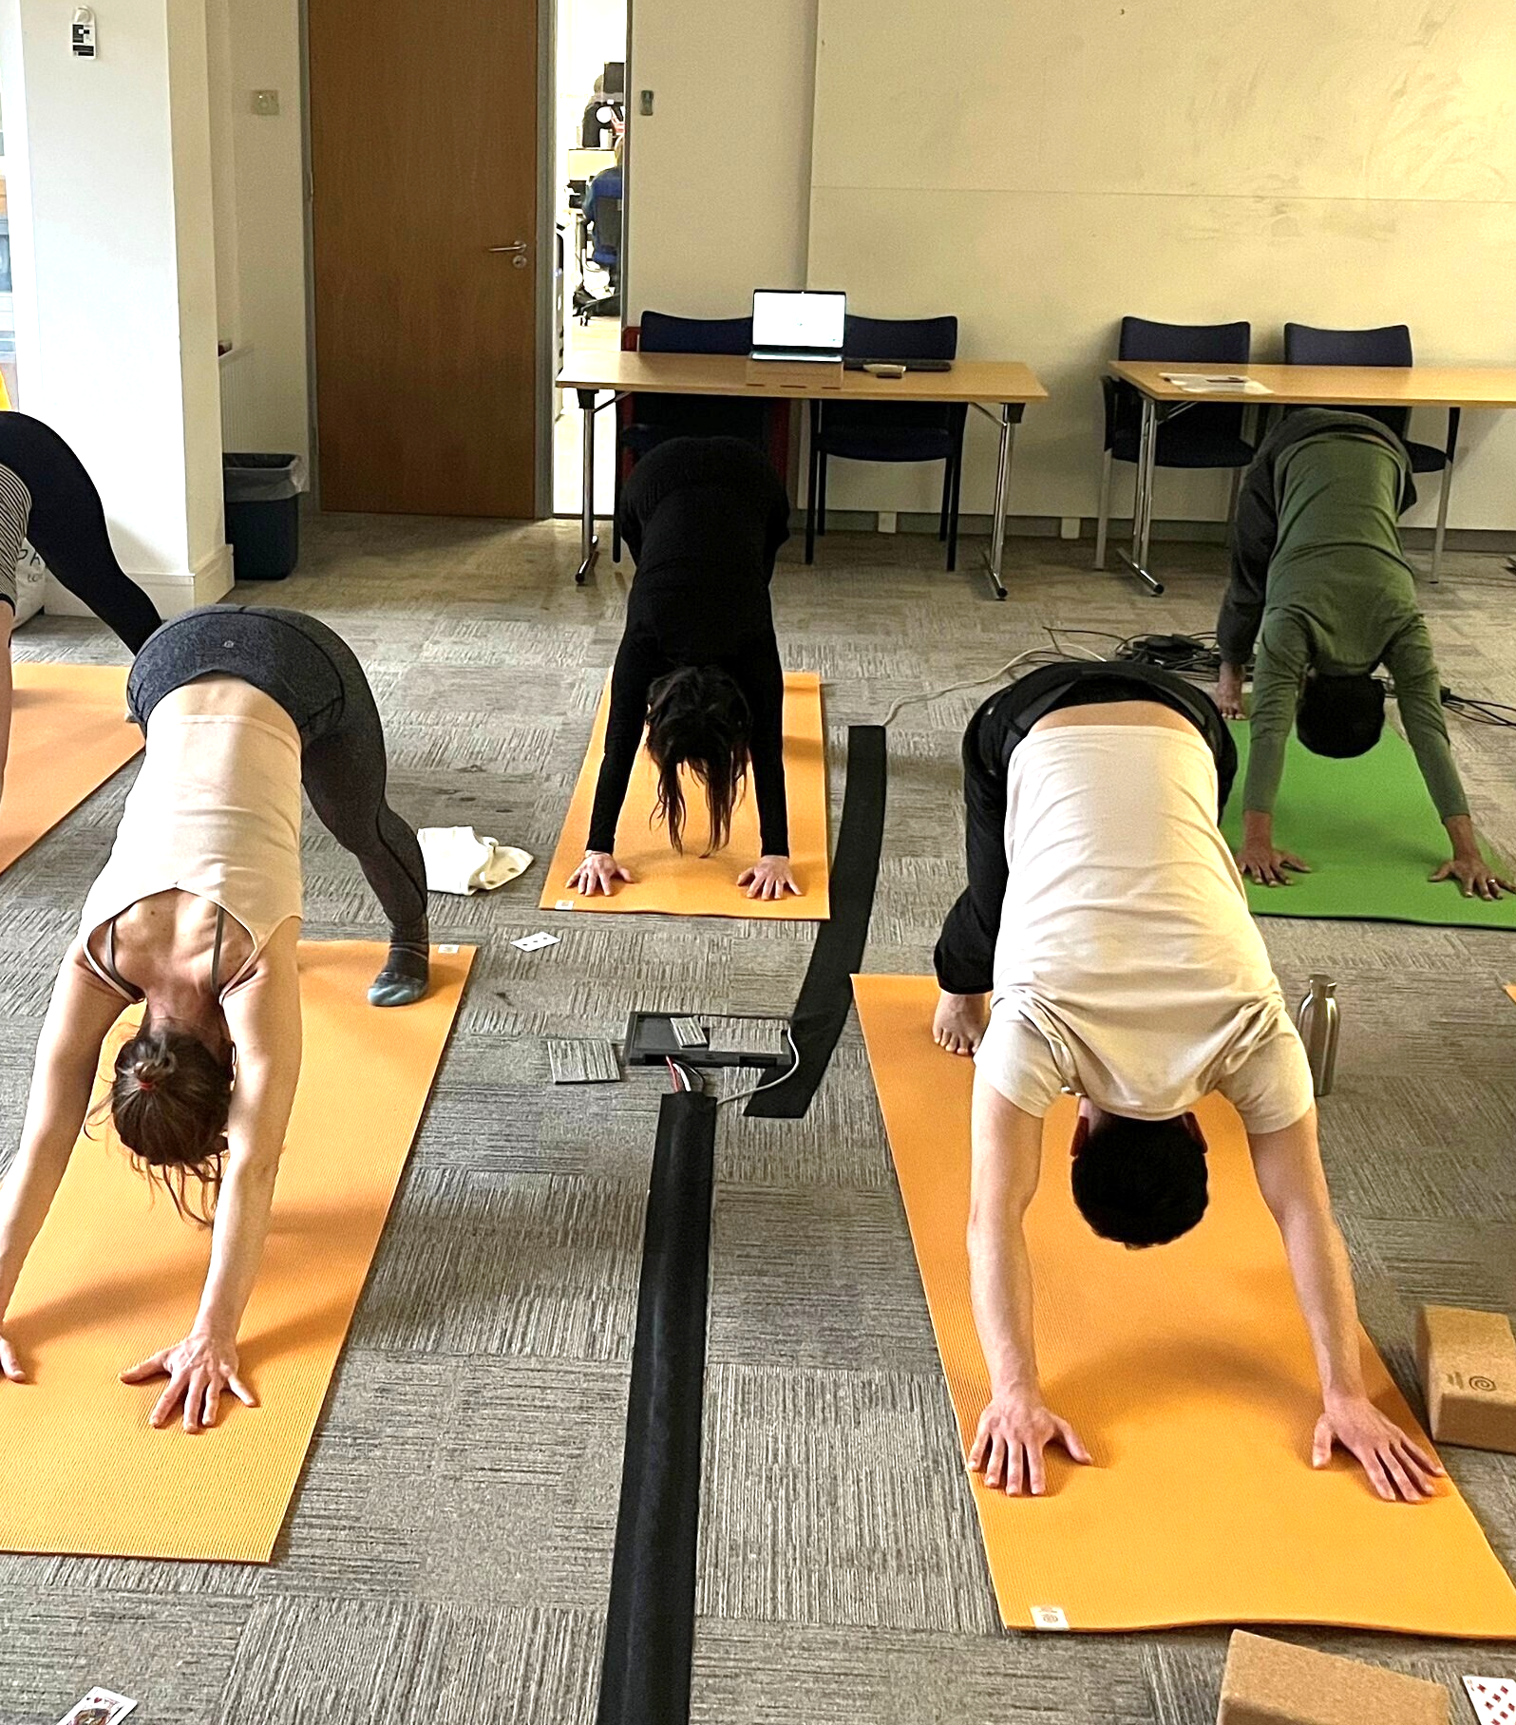
Our culture (cont.)
We want our people to shape how things are done here.
Staff-led groups including Employee Voice and Equity Diversity & Inclusion Working Group give everyone the opportunity to have their voices heard, helping to shape initiatives and policies.
We also have a range of social activities including a book club, wellbeing activities and weekly lunchtime yoga sessions – small things that reflect how we look after each other.
We offer flexible and hybrid working where possible, alongside a TOIL system that recognises your time is valuable outside of work too. We're open about what's working and what isn't, and we act on what our staff tell us.
We invest in people's development, and we work hard to hold on to what we've built together. Many of our staff build long careers here.

Slide 18
What our people say
We regularly ask our staff for honest feedback, and here’s what our most recent survey tells us:
91%
of staff are proud to work at CSE and would recommend it as a place to work.
91%
of staff feel supported by their team.
93%
of staff feel they have the opportunity to share their opinions.
94%
of staff say CSE offers good flexibility of working options.
We use staff feedback to shape how we work, what we prioritise, and where we need to improve.

Slide 19
Staff benefits
Holiday | 25 days annual leave plus bank holidays.
Pension | Company pension scheme - 8% employer, 6% employee contributions.
Lifestyle | Flexible TOIL for additional hours worked, which can be taken when needed. Hybrid working and flexible hours, with core hours of 10am–4pm (role dependent). Access to our benefits platform (Glo), offering discounts, flexible payment options, and a range of optional benefits and services. Cycle to Work Scheme.
Wellbeing | Health cash plan (Medicash): offers compensation for a range of medical treatments, including dental check-ups and eye tests. Life Assurance. Critical illness. Enhanced sick pay. Weekly yoga classes. Employee Assistance Programme. Enhanced maternity and adoption pay. Staff socials.

Slide 20


At CSE, we’re committed to an inclusive, diverse and non-judgmental environment in our workplace. We actively encourage applications from individuals of all backgrounds, identities, disabilities and experiences. Our applicants will be treated fairly, with respect and without discrimination.
While we seek to appoint on merit and we judge all candidates against the same criteria, we understand that women, people from black, brown and other minority ethnic communities and people living with disabilities are less likely to apply to jobs unless they meet every single qualification.
So if you’re excited about this role but your experience doesn’t align perfectly with the job description, please get in touch – you may still be an excellent candidate for this role. For an informal conversation to chat more about the role, email jobs@cse.org.uk.
Equity, diversity and inclusion
We are pleased to be signed up to these initiatives:

Slide 21
How to apply
Applications should be made on the application form under the Head of People role, available at www.cse.org.uk/jobs-volunteering. CVs and supporting letters will not be considered as part of the application process.
Applications should be sent by email to jobs@cse.org.uk or by post to: Reception, Centre for Sustainable Energy, St James Court, St James Parade, Bristol BS1 3LH.
As part of our commitment to ensuring we treat every application fairly, all personal information on the front sheet of the form will be removed before the application is read by the selection panel.
The closing date for applications is 9am on Monday 3 August 2026.
We aim to hold online first interviews w/c Monday 10 August and in person second interviews at our office in Bristol w/c Monday 17 August.
We’d love to hear from you
If you’d like any further information or assistance with the application process, please email us and we’ll be happy to help.
We’re committed to making any reasonable adjustments to meet accessibility needs. If you require this information in a different form, please get in touch.
If you’re excited about this role but you don’t meet every requirement in the person specification, please do get in touch – you may be the perfect person for the role. We’d be happy to have an informal conversation to chat more about the role with you.
To contact us, please email jobs@cse.org.uk.

Slide 22
We look forward to hearing from you!
To stay updated with future opportunities, follow us on LinkedIn or check our current vacancies on our website.

