Slide 1


Smart and Fair 2024-2026
Outcomes and Insights:
Summary Report

Slide 2



Introduction
The Smart & Fair programme was born in 2019. Funded by Scottish & Southern Electricity Networks and National Grid Electricity Distribution, we set out to ensure that the transition to a smart, flexible energy system would be equitable for all. In our first report seven years ago we warned about the emergence of a two-tiered energy system that works well for some but leaves other behind. Our work since then shown that fairness is not emerging naturally from the developing smart energy market as we continue to see disparities in access and participation for different types of households.
The transition to a clean and smart energy system offers unprecedented opportunities to improve both the social and environmental impacts of our energy use. Done in a fair way, this could help deliver less inequality in the energy market; widen public support for the low carbon transition and enable decarbonisation of the energy system at a faster pace and a lower cost. But achieving broader participation and a fair distribution of costs and benefits will require structural change and action from across the energy system. Smart & Fair is a research programme designed to support this change.
The last two years of our work exploring fairness in market design (innovation), real-world engagement (participation), and support systems (advice) has shown that:
A fair smart energy transition won’t happen by itself. It must be designed and delivered across the energy system.
There is progress on fairness, but benefits are uneven and still shaped by existing advantage.
Without action, a two-tier system will deepen, undermining trust and impact.
Now is the moment for coordinated action: inclusive markets, strong oversight, and scaled advice.
This short report summarises our insights and recommendations for delivering this coordinated action. Download the full report here.

Slide 3
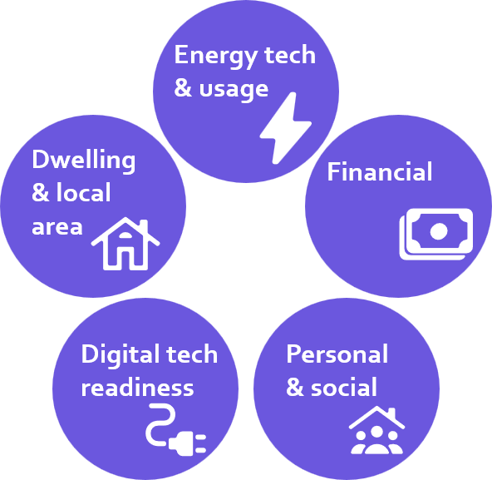
Approach
Aims
To understand who benefits and who is at risk of being left behind we developed the Smart Energy Capabilities Lens. This theoretical framework describes the factors that affect a household’s ability to access different smart energy offers and effectively participate in emerging energy markets. The Capabilities Lens comprises five clusters of capabilities – shown below.
Smart and Fair focuses on three system levers: markets, participation, and advice. Each of these focus areas engages with different aspects of the Capabilities Lens. Inclusive Innovation asks what capabilities market offers require. Understanding Participation explores how capabilities shape real-world engagement. Advice aims to address capability gaps. You can read more about the Capabilities Lens here LINK.
Through our work since 2019, we have identified four outcomes that define a fair smart energy transition:
  Responsible networks: System operators support access to cheaper, greener electricity while keeping network costs as low as possible and protecting consumers.
  A diverse market: Products and services that work for a wider range of households, with oversight to ensure fair access and outcomes.
  Good customer outcomes: Suppliers and service providers provide good support and actively get customers on a combination of technology, tariff and behaviour that is right for them, with strong protections in place.
  Confident consumers: People are informed and able to make decisions that help manage their energy costs. They can access advice and support, and know they are protected if things go wrong.
We've seen positive progress on these outcomes in recent years, with several consumer fairness developments driven by government and regulatory intervention, we have also seen some have emerge from the market. But significant gaps remain. The rest of this report sets out our insights around how market design (innovation), real-world engagement (participation), and support systems (advice) interact to shape fairness. And our recommendations for moving closer to these four outcomes through coordinated action across the energy system.
As the market has developed, Smart and Fair has shifted from identifying risks to driving practical solutions, working to build a shared understanding within industry and government of risk factors and mitigation opportunities, building up an evidence base, and using this to support system wide changes.
At the same time, many of the aims of Smart and Fair have started moving into the mainstream as domestic demand flexibility is becoming central to managing the future energy system.
Smart Energy Capabilities Lens

Slide 4
Insights: Inclusive innovation
Smart and Fair has long called for government to analyse distributional impacts to understand ‘winners’ and ‘losers’ across the smart energy retail market. In the absence of this formal monitoring, we've continued to develop our market review and offer profiling to help track and encourage inclusive innovation.
This has revealed a sustained growth in the size and diversity of the smart energy market over the last two years. This is a sign that more customers feel confident enough to participate in smart. But also reflects this is a crucial juncture: mistakes that undermine trust now could be costly. We have seen some encouraging signs in the last two years that the market is delivering more for everyday consumers. There are now more smart tariff options for those without low carbon technologies (LCTs) and a flourishing of demand shifting schemes - an area where we have seen mass participation of more than 2.5 million customers.
But our evidence shows that the current market for smart energy in the UK is two-tiered. Viewed through the Capabilities Lens, these trends show a market continuing to be shaped by pre-existing advantages in income, technology, and housing. Our work using domestic consumer archetypes we developed for NESO reveals big differences between households in both access to offers and benefits (see right).
There is also little evidence that the customer journey is getting simpler as the smart energy market grows – the opposite is true in many cases. This risks further entrenching current market inequalities, leaving only the energy- or tech-savvy able to engage. Taken together, these risks will particularly limit two key outcomes:
  Confident consumers: Complexity and lack of trust undermine consumer confidence and will limit engagement.
  A diverse market: If the market continues to be skewed towards the energy- or tech-savvy this will undermine fairness and limit the reach and effectiveness of the energy transition.

Slide 5
Insights: Understanding participation
Building on the market trends identified in the previous page, we explored how these opportunities translate into real-world participation. Understanding impacts across different customers is increasingly important as policy places greater emphasis on flexibility. The Clean Flexibility Roadmap, for example, sets ambitious targets based on electrification of heat and transport, but implicitly assumes widespread and effective household participation - an assumption not yet well evidenced.
To address this gap, we analysed participation across large-scale flexibility trials and datasets, combining behavioural insight, household characteristics, and real energy outcomes. Strong engagement in trials such as the DFS and CrowdFlex suggests consumer-led flexibility is viable at scale, with a broad base of willingness and capability. Participation also builds awareness, confidence, and openness to automation. However, participation and benefits are unevenly distributed. Higher-income, tech-owning households gain more rewards, while low energy users may bear costs but gain little. Flexibility is also not risk-neutral: some vulnerable households reduce essential energy use to take part, risking reduced comfort or wellbeing.
We also find that current flexibility markets do not fully utilise existing technologies such as batteries and storage heaters. Unlocking this potential requires innovation in products, services, and tariffs, alongside better household support. Barriers are not only technical: improved customer journeys, targeted support, and trusted intermediaries can widen access, but scaling requires investment. Policy options such as default or ‘opt-out’ participation also warrant investigation.
In parallel, incorporating real consumer behaviour into energy system models can improve accuracy, reveal overlooked flexibility, and support fairer network planning.
These dynamics particularly impact two key outcomes:
69% of CrowdFlex participants reported a positive experience.
Areas with lower access to flexibility have lower average incomes
In constraint-managed zones, successful flexibility procurement was associated with a higher share of higher-income households. In contrast, areas where the DSO struggled to procure flexibility had a higher share of lower-income households.
Responsible networks: Uneven participation risks unfair redistribution of network costs.
Good customer outcomes: Without proactive action, trust and confidence, key to participation, may be undermined.
Data: Access to Flexibility p16, 2025

Slide 6
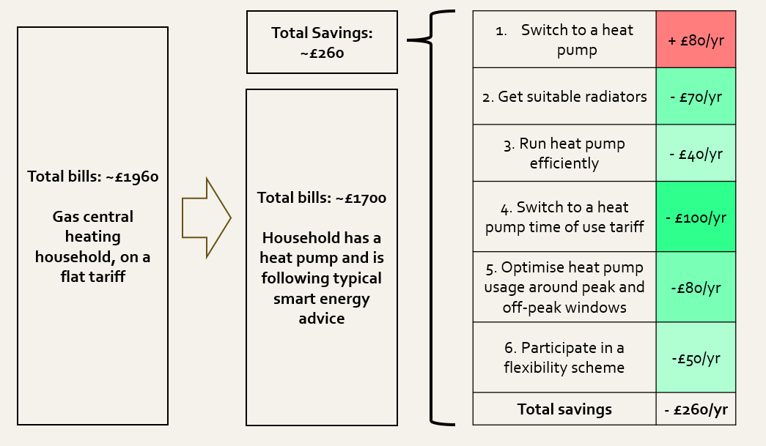
Insights: Smart energy advice
In this complex and rapidly evolving market, accessible and trustworthy advice is essential to help people identify suitable options and overcome capability barriers. CSE has been at the forefront of smart energy advice delivery for five years, underpinned by the Capabilities Lens. We've supported 2,680 households and increasingly focus on supporting grant-funded retrofit journeys, reflecting recognition that advice is essential to ensure intended outcomes.
Our advice work has shown that financial barriers continue to limit access to smart energy technologies. Many households cannot afford upfront costs. Uncertainty around impacts on bills also undermines confidence, reducing uptake and reinforcing distrust. New funding through the Warm Homes Plan and Fund offers opportunities, but effectiveness will depend on how funding, delivery, and advice are integrated. Without this, participation will remain skewed towards those with greater financial capacity: both for capital costs and potential financial risk.
At the same time, complexity and distrust remain major barriers. Evidence from the advice sector highlights that many households are wary of adopting new technologies due to perceived risks, time commitments, complex processes and uncertainty about outcomes. These concerns are particularly pronounced among those in vulnerable circumstances. Evaluation of our Smart Energy Action Plan project shows the significant impact of impartial, tailored advice on understanding and behaviour: 93% of participants reported increased knowledge of smart energy options​ and 75% planned to take at least one recommended action​. But provision is insufficient to meet demand and the effectiveness of the advice sector depends not only on funding, but on ongoing capability development.
Without action, these risks will particularly limit three key outcomes:
Our analysis - shown above - highlights the value of good advice for heat pump users.
A diverse market: Without greater funding, people with lower incomes will remain excluded from the smart energy market.​
Good customer outcomes: Without tailored support there is a risk that good outcomes are not achieved from grant or loan funded installs.
Confident consumers: Without support, many households will not have the confidence, trust and willingness to engage.

Slide 7

Recommendations
Responsible Networks
To help strengthen outcomes around responsible networks so that system operators are delivering greener electricity at costs as low as possible and are responsible in their procurement of flexibility, we recommend:
Short Term (Next 12 months)
DNO’s to develop their enhanced co-ordinator role to enable trusted intermediaries in promoting flexibility, storage and demand side management, actively identifying underutilised sources.
Network and System operators to integrate consumer capability data into system modelling.
Medium Term (1 – 3 years)
Government to establish mechanisms to share flexibility benefits. Transparent mechanisms are needed to measure and distribute the savings from consumer-led flexibility to those who are not directly earning rewards.
A Diverse Market
To help progress towards a diverse market in which we see smart tariffs, products and services that work for people with a variety of needs, or less income, we recommend:
Short Term (Next 12 months)
Government to ensure that the Warm Homes Plan delivers greater, targeted and long-term funding for people in fuel poverty and vulnerable situations.
Government to move ahead with plans to provide more formal market monitoring of smart energy offers.
Offer providers to develop further inclusive innovation aimed at everyday consumers.

Slide 8
Recommendations
Good Customer Outcomes
To help improve customer outcomes through support and customer protection we recommend:
Short Term (Next 12 months)
Offer providers to strengthen customer outcomes monitoring and tailored support, assessing whether customers are participating effectively.
Ofgem to mandate smart offer providers to share more data about offer users and outcomes.
Government to expedite regulation aimed at improving interoperability across the smart energy ecosystem.
Government to require that all grant and finance funded installations include a suitable tariff offer, tailored advice and follow-up support.
Government to review the Smart Export Guarantee process and ensure system benefits are fairly passed on to customers.
Medium Term(1-3 years)
Ofgem to develop new indicators to capture how vulnerability interacts with flexibility, as the current PSR is not designed for this purpose.
Confident Consumers
To help move us closer to confident consumers who are better informed about their choices we recommend:
Short Term (Next 12 months)
Government to establish a designated consumer-led flexibility engagement organisation to work with offer providers to improve the clarity of offer information.
Government to create a national energy transition communications strategy, highlighting the benefits of new tech and services, and actively addressing misinformation and misconceptions .
Medium Term (1 – 3 years)
Government to provide funding and new tools for advice organisations.

Slide 9
Next steps for Smart and Fair
To help deliver these outcomes, over the next two years Smart and Fair will focus on:
Responsible Networks
To continue to support system operators deliver fairness and value for money, we will:
Help networks to identify households at risk of being left behind, to target support and plan more fairly.
Explore how low‑carbon technologies can support resilience for vulnerable customers while strengthening system performance.
A Diverse Market
To help progress towards a diverse market of products and services that work for different types of people we will:
Continue and expand market monitoring, webinars and sector resources, building evidence on who participates and benefits, enabling regulators and industry to identify gaps and drive more inclusive offers.
Good Customer Outcomes
To help improve customer outcomes we will:
Shape options to optimise customer outcomes through tech, tariffs & advice in Warm Homes Plan and Fund installs.
Develop new approaches to understanding vulnerability, enabling better identification of risk and more targeted support.
Provide guidance on safe and effective participation in flexibility services.
Confident Consumers
To support consumer confidence we will:
Explore ways to make smart energy advice more widely available and accessible.
Improve financial analysis of smart energy options and translate this into customer support.
Continue to scale advice sector capacity through training & knowledge sharing.
All of this work will be supported by ongoing engagement to:
Embed the Capabilities Lens across the sector, ensuring consumer needs shape design and delivery.
Strengthen partnerships with market actors and consumer organisations, improving coordination and delivery of better outcomes.
Represent consumer needs in policy and regulation, driving system-wide change aligned with Smart and Fair outcomes.
Increase uptake and use of tools and insights, translating evidence into real-world impact.

Slide 10
Conclusion
This report shows clearly that the transition to a smart, flexible energy system is underway - and that it carries significant opportunities to improve outcomes for households. But it also confirms a central finding of the Smart and Fair programme since 2019: fairness is not emerging naturally from the market and must be actively designed and delivered.
The smart energy market is growing rapidly, with more offers, more participants, and early signs of mass-market engagement. Participation is feasible and often positive, advice can significantly improve outcomes, and innovation is beginning to reach a wider range of households. However, this progress is uneven. Access, participation, and benefits remain strongly shaped by household capabilities, resources, and circumstances, with some households facing barriers, complexity, and greater risk of poor outcomes.
The result is a system that is evolving, but not yet delivering consistently fair outcomes. Participation is conditional rather than universal, advice is valuable but not available at scale, and consumer confidence remains fragile and uneven, with gaps in data limiting understanding of outcomes across different groups. Without change, these dynamics risk becoming embedded, reinforcing a two-tier market and undermining participation, trust, and the wider benefits of the smart energy transition.
Delivering a fair transition requires:
A Diverse Market
Good Customer Outcomes
Confident Consumers
Responsible Networks
Encouragingly, these priorities are beginning to be recognised, but progress is not yet sufficient. What is now needed is a shift from recognising the problem to embedding solutions across the system, with stronger oversight, transparency, inclusive design, scaled advice, and coordination across actors.
With the right interventions, the smart energy transition can deliver both efficiency and equity. Without them, it risks reinforcing existing inequalities and missing a critical opportunity to build a fairer energy system for all.

Slide 11


End slide
We’re a charity (298740) supporting people and organisations across the UK to tackle the climate emergency and end the suffering caused by cold homes.
cse.org.uk

